Slide 1
Magnecraft™ 792 Miniature Plug-In Relays
Sales Presentation
2014

Slide 2
Magnecraft 792 Miniature Plug-In Relay
Agenda:
Session Objectives
Product Offer
Competitive Comparison
Application Memos
Available Support Tools
Call to Action
Notes:
The agenda for today will begin with this session’s objectives, followed by a review of the relay product offer, Competitive Cross Reference, Application Memos, available support tools, and conclude with a call to action

Slide 3

Session Objectives
By the end of this presentation you will know:
The unique value propositions for the 792 relay
The applications where these relays are used
Target customers and markets
Advantages against the competition
Sales strategies
Available support tools and resources
Notes:
By the end of this session, you will know the 792’s unique value propositions, their primary applications, their target customers and markets, and their advantages over the competition. You will also learn which sales strategies to use, where you can find support tools and resources, and whom to contact for technical support.

Slide 4
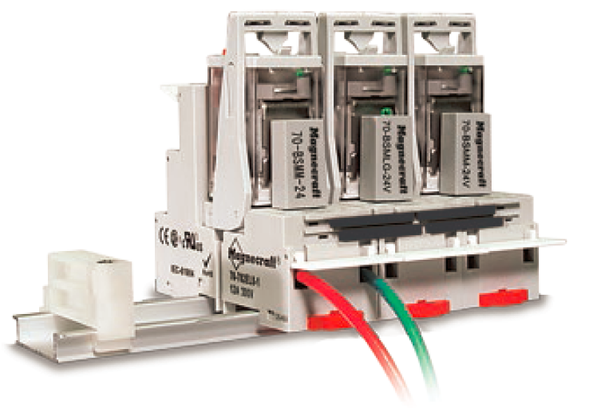

Magnecraft 792 Product Offer
Rated up to 12A and 1 Horsepower
  Ideal for controlling small motors and pumps
Low Level Switching Versions
  Capable of switching 3A low signals in monitoring applications
2 and 4 Pole Models
  Saves space in automation panels
Drop-in Replacement for Omron MY Series
Notes:
The new 792 Relay is the direct replacement for the 782 control series relay.
They are an industry standard plug-in relay and socket design, but as you’ll see our product features differentiate us from the competition.
With ratings up to 12 A and 1 Horsepower, the 792 relays are ideal for controlling small motors and pumps.
2 and 4 pole models allow you to simultaneously control separate, individual circuits while conserving precious panel space
3A Low-level switching versions are also available; these are for switching low signals in monitoring applications.
Also our relays are a drop-in replacement for Omron’s MY series

Slide 5
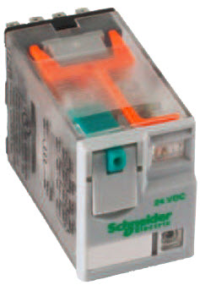
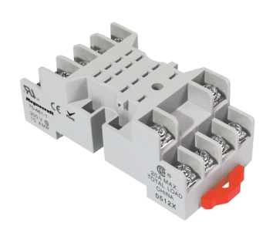
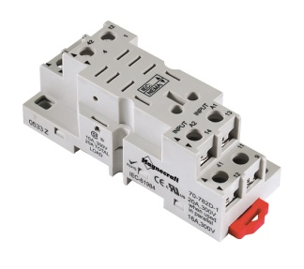
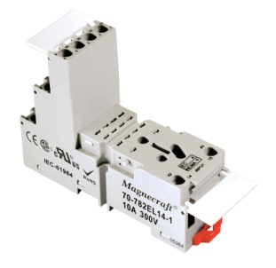
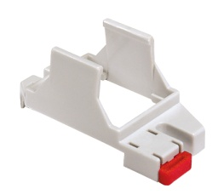
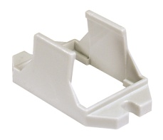
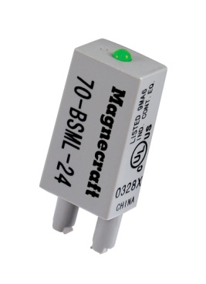
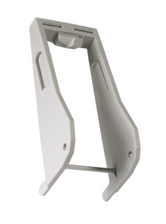
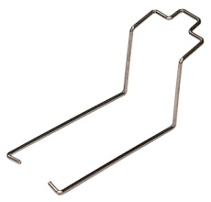
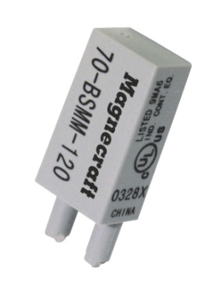
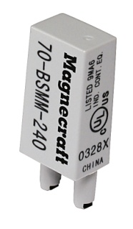
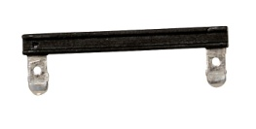
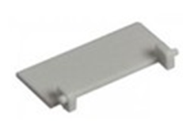
Magnecraft 792 Complete System Solution
Signature Full-Feature Cover
  Test Button + Lock-Down Door
  LED, Mechanical Flag Indicator
  Gold-Flashed Contacts
Sockets and Mounting Adapters
  Mixed and Separate Terminal Styles Available
  Din Rail and Panel Mount Styles Available
Modules
  LED Indicator
  Protection Diode
  MOV Suppressor
Additional Accessories
  Ejection Clip
  Retaining Clip
  Bus Jumper
  ID Tag
Notes:
The 792 family stands apart from competition due to our “Complete System Solution”, which means the complete installation (socket, relay, clips, bus jumpers … whatever components you choose) are UL Listed as a complete product when your installation is finished.
What are our differentiators …
1st Our signature full-feature cover incorporates a test button with a lock-down door along with LED and mechanical flag indicator. Why is this important – you can check the connections and wiring without having to power ON the relay. This gives the installer a measure of convenience and some protection and also reduces the risk of mis-wiring which could lead to equipment damage.
2nd Our sockets and accessories – We have one of the broadest line of sockets in the industry, this includes Mixed and Separate style Terminals, as well as options for din rail or panel mount to suit your applications need. These sockets give customers the option of incorporating protection modules, which help protect the installation from surges and transients that may come through the control panel, along with ejection clips, bus jumpers, and ID tags.
3rd – as noted earlier, our “Complete System Solution” is UL Listed.
And finally, our gold-flash contacts decrease contact oxidation. Why is this
important?
First time performance after long periods of inactivity
And increased shelf life for distributor stock and customer spares

Slide 6

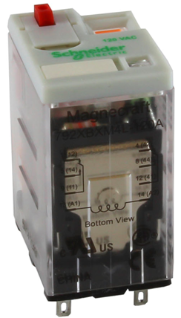
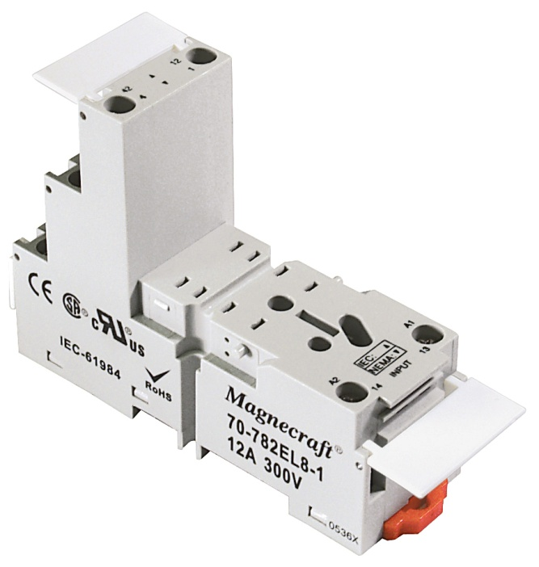
Magnecraft 792 Competitive Comparison
 | Magnecraft 792 | Omron MY | Idec RU | Tyco KHA
Gold flashed Contacts | YES | NO | NO | NO
DPDT | 12A | 10 A | 10 A | 15 A
4PDT | 6 A | 5 A | 6 A | 5 A
Locking Test Button | YES | NO | NO | NO
Mounting Adapters | YES | NO | NO | NO
UL Listing | Relay /Socket Combination UL Listed | NO | NO | NO
Bus Jumpers | YES | Socket “bridge” Offered | Only Spring Clip Socket | NO
Notes:
A quick look at the competition and you’ll see that the Magnecraft 792 has a clear advantage in terms of features and performance.
And don’t forget … the “Complete System Solution” is a huge benefit for OEM’s and Panel Builders … a UL Listed Relay and Socket combination.

Slide 7
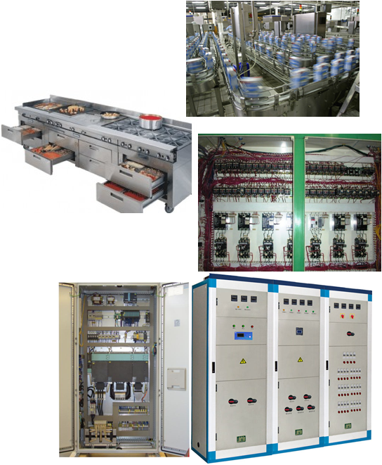
Magnecraft 792 Applications
Food and Beverage Processing
  Commercial/Industrial cooking equipment
  Filtration systems
  Bottling controls
  Chilling units
Material Handling Equipment
  Small Motor Control
  Conveyor Control
  Control System Isolation
Lighting
  Motorway information systems
  Lighting Control Panel
Notes:
Packaging and material handling equipment use relays for controlling motors, solenoids, compressors, and blowers.
Relays are also used in lighting control systems, and applications where there is a need to isolate sensitive equipment from possible surges and transients.

Slide 8
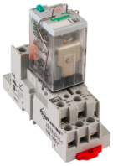
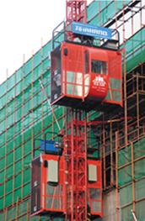
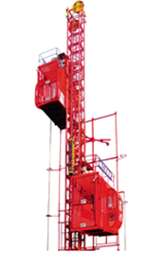
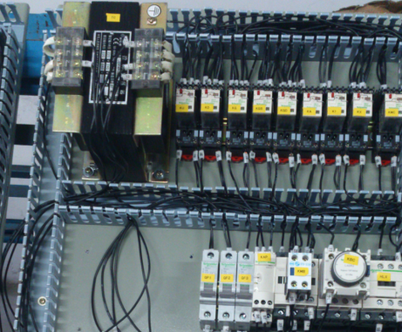
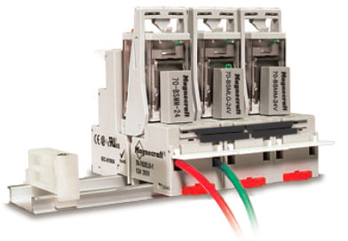
792 Relay Application Example
Construction Industry
Application Criteria
Keys to Success
Requirements:
Small Motor control
10A minimum
Construction elevator and
hoisting equipment
Relays are used in control
panels for construction
elevators
Industry
12 A rating in a small package provides 20% buffer for inrush loads.
Full-feature cover (lockable test button, LED) for easy installation and diagnostics
Customer Pain:
Panel space was limited.
Could not test relay output locally for trouble shooting.
Application
Magnecraft Complete Solution
Competition
Magnecraft relays
Sockets
MOV module
Ejector clip
Bus Jumper & ID Tags
Omron / IDEC
Advantage:
Magnecraft

Slide 9
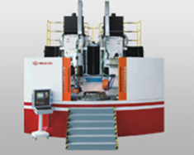
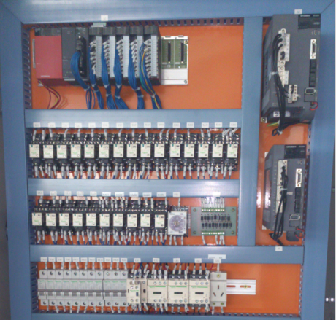
792 Relay Application Example
Machine Tooling
Application Criteria
Keys to Success
Requirements:
Interface between PLC
and contactors
The ability to test incoming and outgoing signals
Machine tooling equipment
Automation control panel for
grinding machine
Industry
3A control low signal rating in a small foot print
Full-feature cover (lockable test button, LED) for efficient installation and diagnostics
Application
Customer Pain:
Panel space was limited.
Could not test relay output locally for trouble shooting.
Magnecraft Complete Solution
Competition
Magnecraft relays
Sockets
Diode module
Ejector clip
Bus Jumper & ID Tags
Omron
Advantage:
Magnecraft

Slide 10
Magnecraft 792 Relay Support Resources
Web Page
  Magnecraft 792 Series Relays
  Magnecraft General Purpose Relays - Overview
Literature
  Magnecraft 792 Plug-In Relay Data Sheet
eLaunch Document
  Magnecraft 792 Plug-In Relay eLaunch Document
Web Tools
  Magnecraft 700 Series Parametric Search
  Magnecraft Socket Tool
Notes:
Links to all relevant support material can be found at www.serelays.com
SERelays.com provides you with the ability to download 2D/3D CAD drawings, Product Images, Interactive eCatalogs, Parametric Search, Environmental Considerations, and much more!

Slide 11
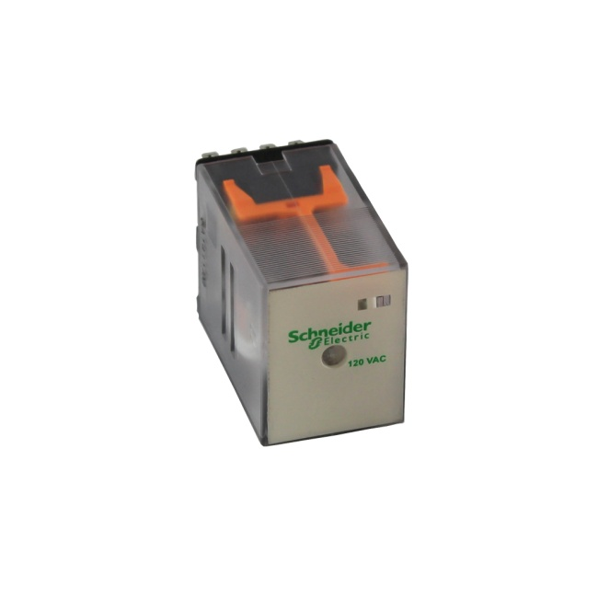
Call to Action
Review all available sales support material
Engage customers already using 782 control relays
and present the new 792 Magnecraft series
Identify customers using competitor products
and convert to Magnecraft

Slide 12
Summary
Magnecraft Plug-In Relays deliver the “Complete System
Solution” to simplify any design and expedite installation.
The 792 Relay Series optimizes flexibility with the Magnecraft
signature full-feature cover, sockets, panel & DIN mounting
options, protection modules, and other accessories.
The Magnecraft Advantage comes not only from the reliability,
simplicity and design innovation found in the entire relay offer,
but also from the web tools and online resources found at
www.serelays.com

Slide 13
Magnecraft™ 792 Miniature Plug-In Relays
Sales Presentation
2014
Thank You!

